Slide 1
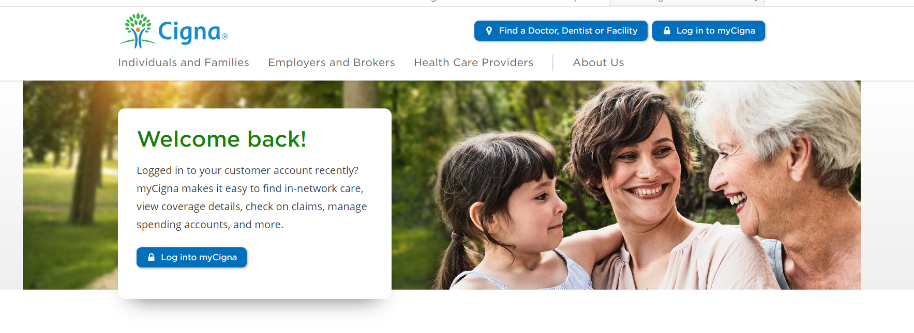
How to Find a Cigna Provider
www.cigna.com

Slide 2
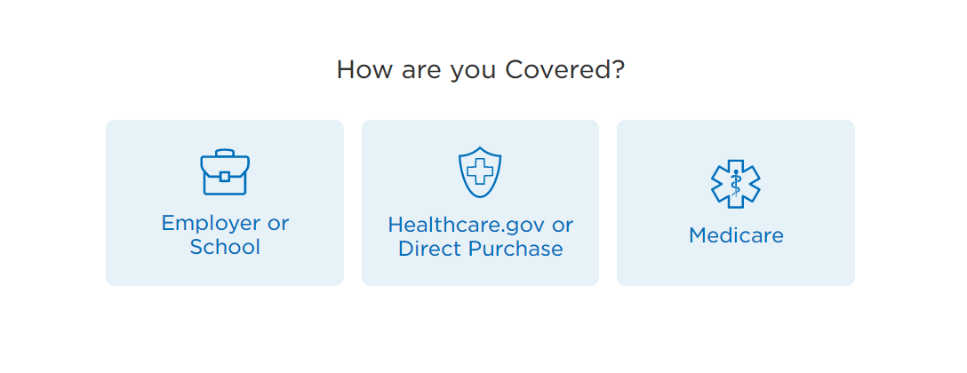
How to Find a Cigna Provider

Slide 3
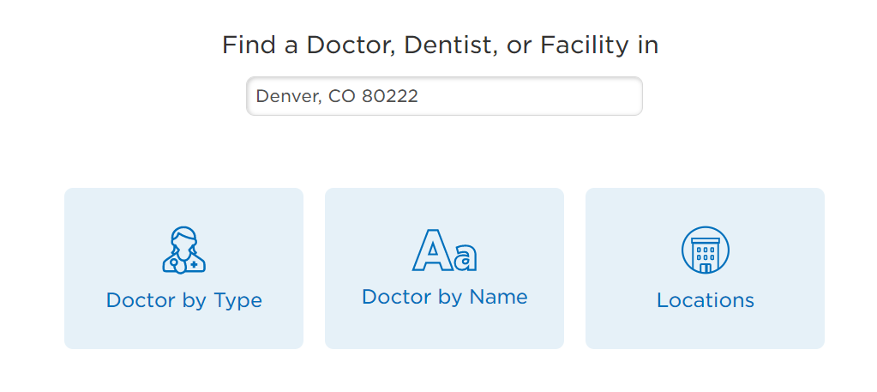
How to Find a Cigna Provider
Enter the address, city or zip code for the provider or area you’re looking for
If you have a specific provider you’re looking for, select Doctor by Name

Slide 4
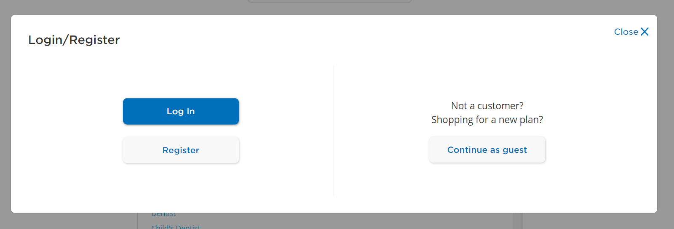
How to Find a Cigna Provider in the LocalPlus Network
Click on Continue as guest, so you can search for a provider in the LocalPlus network

Slide 5
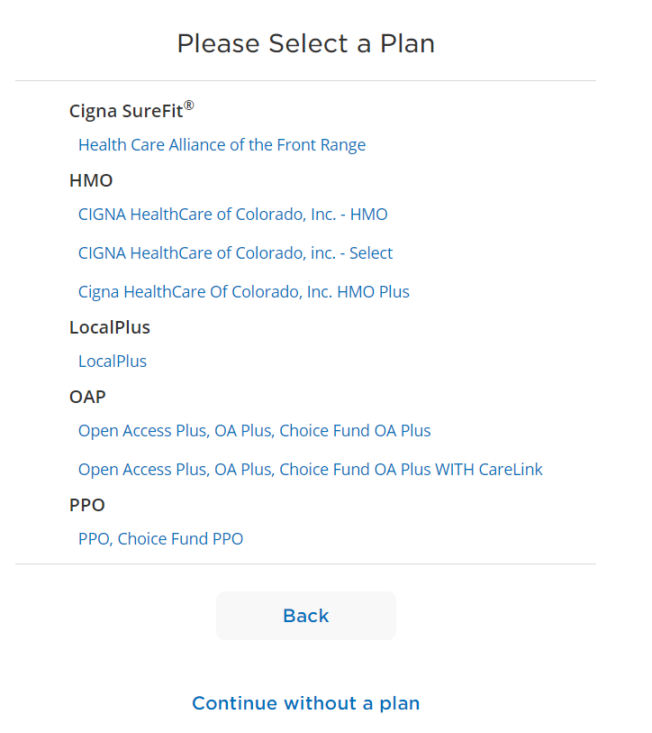
How to Find a Cigna Provider in the LocalPlus Network
Click on LocalPlus to see a list of providers available in this network

Slide 6
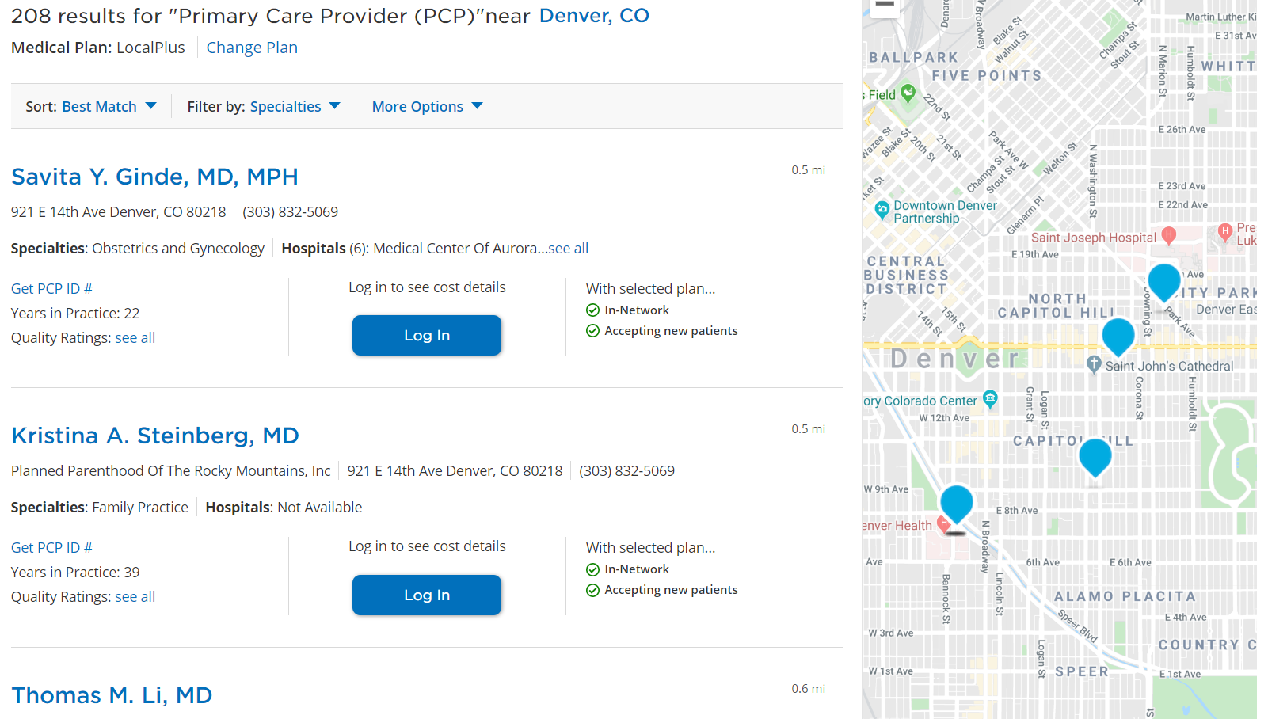
How to Find a Cigna Provider in the LocalPlus Network
Scroll through the list provided to find out more information about each provider in the network. You can also see where they are located based on the map.

Slide 7
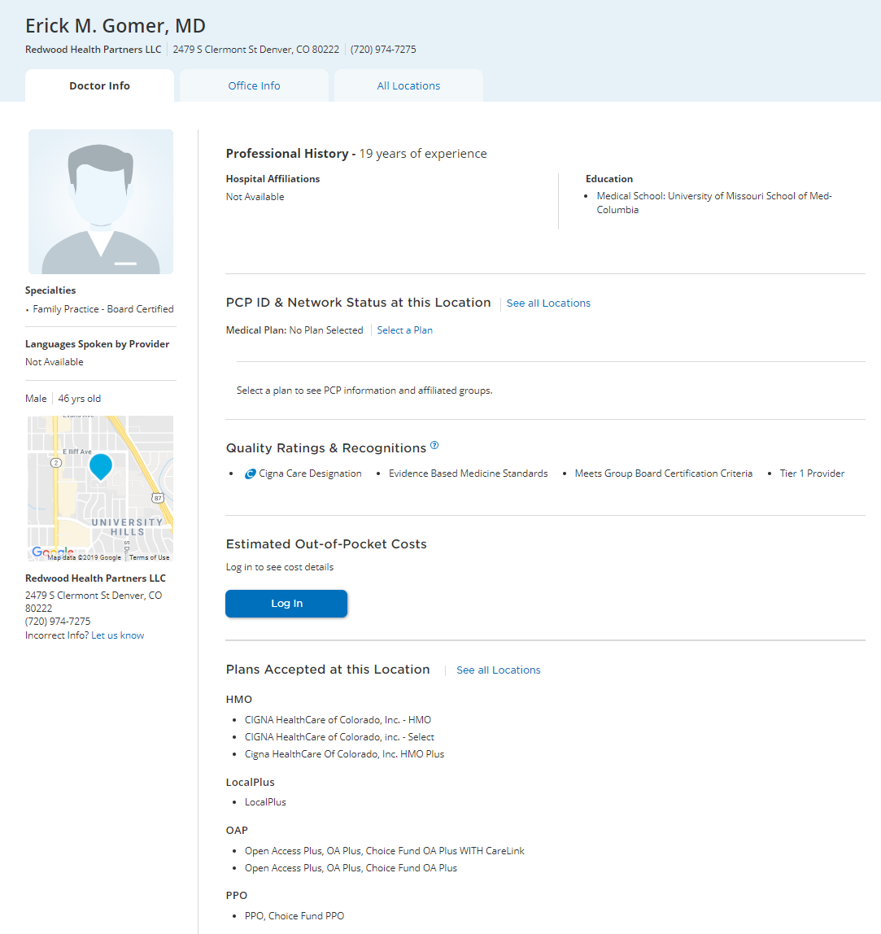
How to Find a Cigna Provider in the LocalPlus Network
2
When you see the blue “c” icon, that indicates a provider with Cigna Care Designation. These providers are considered to be highest in quality and cost-efficiency.
1
A list of all plans accepted by the provider will display. For your medical plan coverage, you’ll want to look for LocalPlus or Open Access Plus indicated by the arrow below.

